Slide 1
Program Testing + Integration Testing

Slide 2
Software Faults and Failures Why Does Software Fail?
Wrong requirement: not what the customer wants
Missing requirement
Requirement impossible to implement
Faulty design
Faulty code
Improperly implemented design

Slide 3

Objective of Testing
Objective of testing: discover faults
A test is successful only when a fault is discovered
Fault identification is the process of determining what fault caused the failure
Fault correction is the process of making changes to the system so that the faults are removed

Slide 4
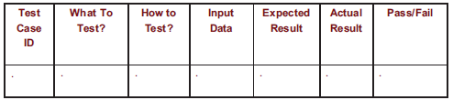
Elements of a Test Case
Purpose
Input
Expected Output
Actual Output
Sample Format:

Slide 5
Types of Faults
Algorithmic fault
Computation and precision fault
a formula’s implementation is wrong
Documentation fault
Documentation doesn’t match what program does
Capacity or boundary faults
System’s performance not acceptable when certain limits are reached
Timing or coordination faults
Performance faults
System does not perform at the speed prescribed

Slide 6
Software Faults and Failures Typical Algorithmic Faults
An algorithmic fault occurs when a component’s algorithm or logic does not produce proper output
Branching too soon
Branching too late
Forgetting to initialize variable or set loop invariants
Comparing variables of inappropriate data types

Slide 7
Testing Issues Attitude Toward Testing
programs are viewed as components of a larger system, not as the property of those who wrote them

Slide 8
Testing Issues Who Performs the Test?
Independent test team
avoid conflict
improve objectivity
allow testing and coding concurrently

Slide 9
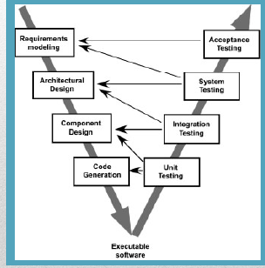
Recall the V model of Software Engineering

Slide 10
Testing Concepts
Testing is a systematic approach to find and identify faults. It is NOT intended to show that there are no faults. ( A successful test finds faults. )
A fault is a coding error that may lead to an erroneous state.
An erroneous state is a run-time state as a result of a fault, that could lead to failure.
Failure occurs when the system fails to operate as required.

Slide 11
Component Inspection
Careful detailed review of a component by a team of qualified reviewers. ( Usually 3 – 5 )
“Components” may include code, documents, diagrams, procedures, or just about anything.
Usually conducted with the aid of checklists pre-approved by all involved.
There are several different published approaches to conducting inspections.

Slide 12
Typical Approach to Code Inspection – I
Review team may include ( experienced ) programmers and/or relevant experts.
Components to be reviewed may be distributed prior to the first meeting.
First meeting – Author presents and explains the component(s) to be inspected.
Reviewers separate, and inspect the component(s) individually with aid of checklist(s).

Slide 13
Typical Approach to Code Inspection-II
Second meeting – Reviewers present their findings to the author.
Author not allowed to speak unless asked a question.
No suggestions for corrections or improvement given at this meeting. ( Reviewer(s) may meet with author separately for that purpose later. )
It is important to maintain an attitude of helpfulness, not criticism.
Optional follow-up meeting may review changes

Slide 14
Some benefits of Inspection
Can be applied to components that can’t be tested – documents, rarely encountered code.
Code can be tested in the absence of necessary supporting HW and SW.
More than one error can be found at once.
Style and good practices can be inspected.
Inspections typically find more faults faster.
However inspections do not replace testing.

Slide 15
Black Box VS White Box Testing
Black box tests are developed without knowledge of the internal workings of the component being tested. – Acceptance tests are typically black box.
White box tests are developed based on knowledge of the internal workings of the component being tested. ( a.k.a. clear box. )
Unit tests may be black box or white box.
( Gray box tests use knowledge of the algorithms / data structures in use but not the specific code. )

Slide 16
Black box VS white box
Closed box or black box: functionality of the test objects
Equivalence Class, Boundary Value Analysis, Scenario-based, Decision Table based, State Machine based…
Clear box or white box: structure of the test objects
Control Flow
Basis Path, Branch, Statement, Decision…
Data Flow
Du Path, All-uses Path

Slide 17
Equivalence Classes / Testing
It is rarely possible in practice to test all possible values of all input variables.
An Equivalence Class is a range of input values for which the results are expected to be equivalent. ( The same errors are expected. )
Equivalence Testing strives to include at least one test case involving every (combination of) equivalence class(es).

Slide 18
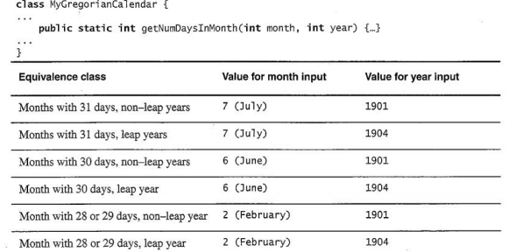
Example: what equivalence classes can be identified?

Slide 19
Boundary Testing
Related to Equivalence Class Testing
Boundary Testing recognizes that errors most commonly occur at the boundary of equivalence classes.
This is particularly true at the boundary between valid and invalid inputs. ( Off by 1 errors. )
Consider array[0], array[1], array[N-1], array[N].
Also consider extremely large, small, or negative values, & uninitialized or missing values.

Slide 20
Levels of Testing
Module testing, component testing, or unit testing
Integration testing
System Testing
Function testing
Performance testing
Acceptance testing
Installation testing

Slide 21
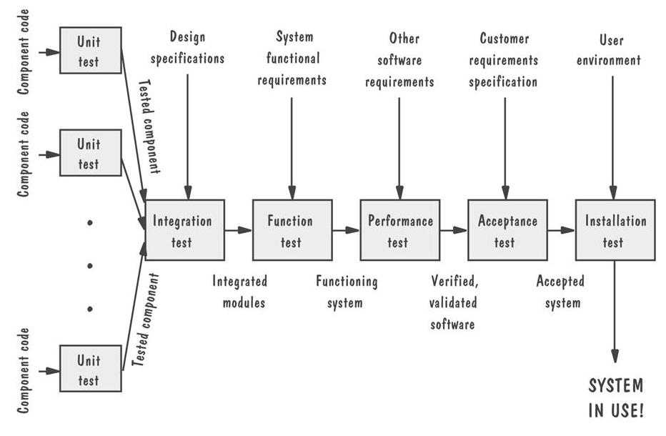
Levels of Testing Testing Organization Illustrated

Slide 22
Unit Testing (done by developers) Code Review
Code walkthrough
Code inspection
Testing the unit for correct functionality
Testing the unit for correct execution

Slide 23
Cyclomatic Complexity
Cyclomatic complexity is a source code complexity measurement that is being correlated to a number of coding errors.
Calculated by developing a Control Flow Graph of the code that measures the number of linearly-independent paths through a program module.
Lower the Program's cyclomatic complexity, lower the risk to modify and easier to understand. It can be represented using the below formula:
Cyclomatic complexity = E - N + 2*P where, E = number of edges in the flow graph. N = number of nodes in the flow graph. P = number of connected components

Slide 24
Cyclomatic Complexity
Cyclomatic Complexity = E – N + 2 = 9 – 9 + 2 = 2

Slide 25
Cyclomatic Complexity Range
methods between 1 and 10 are considered simple and easy to understand
values between 10 and 20 indicate more complex code, which may still be comprehensible; however testing becomes more difficult due to the greater number of possible branches the code can take
values of 20 and above are typical of code with a very large number of potential execution paths and can only be fully grasped and tested with great difficulty and effort
methods going even higher, e.g. > 50, are certainly unmaintainable

Slide 26
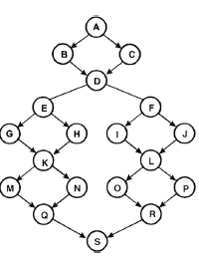
Find Cyclomatic complexity

